Slide 1
Introduction
1
CS/COE 0449 Introduction to Systems Software
wilkie
(with content borrowed from Vinicius Petrucci)
Spring 2019/2020

Slide 2
Syllabus / Administrivia
I’m obligated to inform you that this is, in fact, a university course.

Slide 3
Welcome!
Hello!
I’m wilkie.
I do research and implementation on Distributed Systems.
My area of research interest is Software Preservation / Repeatability
I’ve worked on Social Networks, Embedded Systems, Operating Systems, and Virtualization-based software archival.
I have a full-time job! Bear with me!
Traditional Computer Scientists think I’m “weird” I think…

Slide 4
All the fun on Day One
This is Introduction to Systems Software CS/COE 0449 !!!
Course website: https://wilkie.github.io/cs449
Schedule
Syllabus
Announcements
LOOK AT THE WEBSITE
Office: 5413 Sennott Square (across from the mail room)
Office Hours: TBA

Slide 5
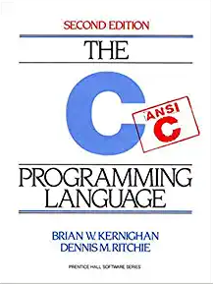
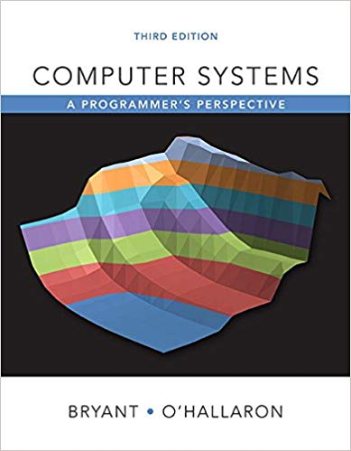
The Textbooks
The ANSI C Programming Language (2nd Edition)
By Brian Kernighan and Dennis Ritchie
Published by Prentice Hall, 1988
Often called the K&R book.
Conventions referred to as K&R style.
Old but trusty!
Computer Systems: A Programmer’s Perspective (3rd Edition)
By Randal E. Bryant and David R. O’Hallaron
Published by Pearson, 2016

Slide 6
Course Layout
Lectures
Present high-level concepts.
Recitations
Applied concepts and introduce tools and skills for lab-work.
Clarify lectures and review topics.
Programming Assignments (Labs)
THE BULK OF YOUR COURSEWORK!
Roughly two weeks per assignment.
Provide deeper dive into some new skill or systems concept.
Programming, measurement, design.
Exams (Midterm + Final)
Tests comprehension of concepts

Slide 7
Policies: Lab Assignments
Collaboration
You MUST WORK ALONE on all lab assignments.
Submission
Electronic submission using Gradescope (no exception)
Check due dates on the course website
Thoth Machine
Many labs will assume the use of a specialized machine.
You must use this machine:
ssh thoth.cs.pitt.edu
Use your Pitt username and password.
Talk to your TA if you have any issues. (Do NOT start assignments late!)

Slide 8
Policies: Late Work
You get 5 Late Days
Covers most normal setbacks and life and schedule mishaps.
A maximum of 2 Late Days per lab assignment.
That is, assignments 3 days late will always take at least 1 penalty day.
When you run out…
Late penalty incurs a 15% penalty for each day. (out of original 100%)
An assignment cannot be submitted after the 3rd penalty day.
Four days late: that’s a 0.
Emergencies
Major emergencies require haste communication with me and your advisor.
Start everything early!!

Slide 9
Policies: Grading
I don’t keep track of attendance
But you should come to class!
A lot of the concepts are best demonstrated interactively.
Labs: 50% (Weighted according to effort)
Midterm: 20%
Final: 25% (Necessarily Cumulative)
Homework: 5% (Online problem sets)
You CANNOT pass without doing the lab assignments.

Slide 10
Policies: Conduct / Academic Integrity
Disability Resources / Services:
Contact DRS 412-648-7890; TTY: 412-383-7355
They will email me, and I will listen to what they tell me to do.
Cheating:
First time: 0 on the lab/assignment/project/exam
Second: Fail the course. Reported. (Applies to all involved.)
Pro-tip: DON’T CHEAT. Start early. Ask appropriate staff for help.
The syllabus online has a more thorough policy.
Conduct:
Jokes/comments about sex, gender, race, ethnicity, religion, etc are not tolerated. Includes any online spaces involved.

Slide 11
More Notes about Cheating
Again, do not cheat.
I’m not grading lab assignments, but I still look at your work.
Ask for help (There are PLENTY of resources)
TAs and my own office hours
Undergraduate Helpdesk (CRC)
We want you to succeed!
I can definitely tell when someone cheats.
It is very obvious.
Do not do it.
The University is justifiably strict about it.
Do not publish your code until after the semester (if at all)

Slide 12
Teaching Pedagogy / Philosophy
I don’t like teaching from slides or from a book.
You can do that yourself. I prefer interactivity.
I want to demonstrate practical applications.
Including humanist and artistic applications.
I want you to walk away with a direction/goal to do something else.
Hopefully, you find something to be inspired by.
I trust my students that they could learn on their own.
But don’t want them to have to do so.
Ask questions! Challenge concepts! Ask for help!

Slide 13
Course Overview
If food were knowledge, this would be, like, our restaurant menu.

Slide 14
Topics (Subject to deviation)
We’re going to (tentatively) learn SO MUCH fun stuff!
The C Systems Programming Language
Some x86 Assembly
Memory Models
Addresses and Pointers
Memory management
Memory Caches
Operating Systems
Processes / Signals
Interprocess Communication
The Basics of Virtual Memory
Basic Network Programming

Slide 15
Skills
C Programming
Abstractions and coping without them
x86 assembly (ISA) / calling conventions (ABI)
Interactive debugging
Data representation
We gain an appreciation of abstraction (and respecting limitations)
Systems Design
Learning the “why” for many systems abstractions
Manipulating systems and existing programs
Thinking about how systems might change in the future
We demystify software so as to no longer be a hostage to its design

Slide 16
What is Systems?
Systems is broad
A subfield of CS dealing with the interactions between software/hardware.
A layer that provides abstractions and must constantly reevaluate them.
Operating Systems
File Systems
Program Analysis / Debugging Tools
Intra/Inter System Protocols
A house built from trade-offs in approach…
Do you build better hardware? Add more memory?
Or, do you design better software?
And trade-offs in design…
Do you choose the specialized path?
Or, do you create a general system?
Both??
Very opinionated!!!!!!!!!!

Slide 17
What is Systems??
Looking for guidance by looking at recent research:
Research Conferences
SOSP/OSDI/EuroSys – OS design, kernel design, virtualization
Parit models: erasure-coded resilience for prediction serving systems
Teechain: a secure payment network with asynchronous blockchain access
Finding semantic bugs in file systems with an extensible fuzzing framework
File systems unfit as distributed storage backends: lessons from 10 years of Ceph evolution
Snap: a microkernel approach to host networking
HotOS – Positions on Systems’ future
Machine Learning Systems are Stuck in a Rut
I/O Is Faster Than the CPU -- Let's Partition Resources and Eliminate (Most) OS Abstractions
I'm Not Dead Yet!: The Role of the Operating System in a Kernel-Bypass Era
Unikernels: The Next Stage of Linux's Dominance
The Case for I/O-Device-as-a-Service
Granular Computing

Slide 18
Why the C Programming Language?
Because B sucks and D wasn’t invented yet. J/K.
C was invented in 1972 alongside UNIX to an effort to aid application development of that system.
Eventually UNIX itself was rewritten in C cementing C as a systems language.
As such, C provides a high-level abstraction of assembly / machine-code and a low-level abstraction of memory, from the perspective of the C programmer.
This is important for programming systems code!
Allows full manipulation of memory (to one’s peril, often.)
This, in turn, allows for full manipulation of cpu/hardware.

Slide 19
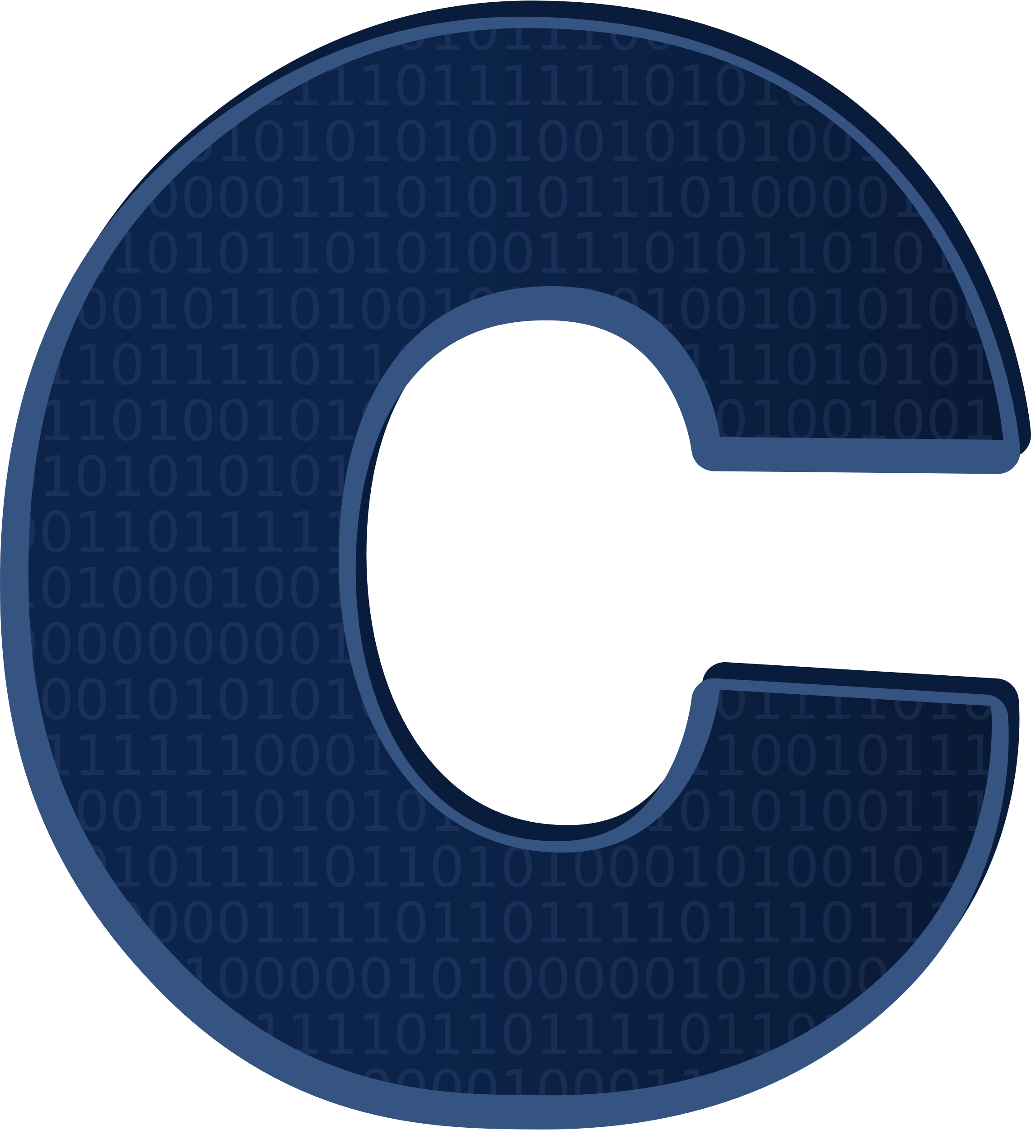
Why the C Programming Language??
Learning C helps you understand Systems.
Understanding Systems lets you make them better.
Or break them. ☺
C reveals the underlying memory model and execution environment.
Lets you understand any program.
Even if you do not have the original code.
Failing at C helps you learn…
Because then you debug your program.
And debuggers are very useful tools.

Slide 20
How people use these skills
Writing Operating Systems
not the entire thing hopefully
… but parts are generally gonna be C/C-like
Understanding systems means knowing how to mitigate/improve performance.
Important that your abstractions don’t hurt performance because EVERY user application suffers.
Yet, performance is not the only consideration; understanding abstractions should help alleviate design fatigue. https://wilkie.how/posts/kaashoeks-law
Linux and Device Drivers: 10+ million lines of C
Yikes.
But, learning C means you can potentially read this and learn more about / improve / extend Linux.

Slide 21
How people use these skills
Debugging Higher-level Programs
Yes, even Python itself crashes!
… and the Python interpreter is written in C …
… and computers don’t understand C …
… so it’s gonna give you an assembly dump.

Slide 22
How people use these skills
Creating Art
Real-time art includes not just video games.
There is a lot of fun and skill involved.
Being creative within a constraint has been very alluring.
The Demoscene is such a community.

Slide 23
How people use these skills
Breaking Things for Great Good
Or great bad… I’m not your parents.
Why? Old programs with copy-protection are still useful.
Original source code backed up?? What time do you think this is?? Never????
And it is technically legal to reverse-engineer and/or change them.
The best kind of legal.
But I’m not a lawyer and this is not legal advice. lol
You will typically use a “debugger” to break down a program’s behavior.
And then patch it to do / not-do things.
Generally done professionally by librarians/archivists.
We will also do this!!

Slide 24
How YOU will use these skills
All of the above!!
And, of course, TO HAVE FUN!!

