Slide 1
5
1
2
CS/COE 0449 Introduction to Systems Software
A Case Study
wilkie
Spring 2019/2020

Slide 2
History and Overview
I swear C is not really as hellish as this makes it seem.

Slide 3
Basic information
First published as a mail-order shareware title in 1993 by Id Software; published by Apogee.
A gritty-for-its-era early first-person action video game eventually defining the First-Person-Shooter genre (FPS)
You play as a lone space marine in a survival-horror setting, albeit cartoony by today’s standards, attempting to get to the exit of each level.

Slide 4
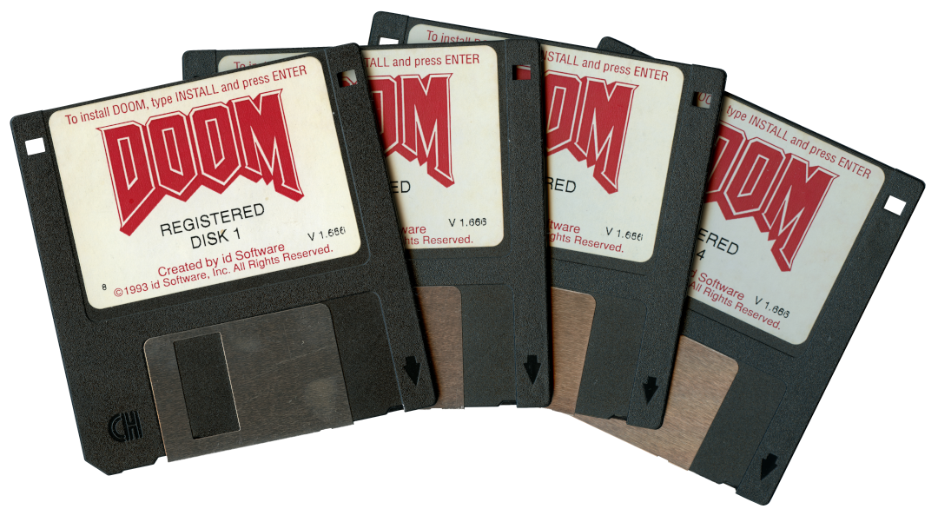
Yes, it was distributed on save icons
DOOM originally came via mail-order purchase on four high-density floppy disks, a relatively large number at the time.
1.44MB (or 1.41MiB) per disk is still quite the constraint.
Some modern websites download more data just to load their front page.
Yes. I have… every single version they ever released. On disks. Shut up.

Slide 5
An evergreen controversy
Although cartoony today, the game’s violent aesthetic stood alone upon release causing a stir still reverberating today.
The violence and satanic depictions throughout the game caused a stir among more conservative crowds.
The game was famously used by now-disgraced lawyer and activist Jack Thompson in his effort to highlight a possible (likely slightly true) correlation between games and real-world violent acts.
It was also infamously referenced by at least one of the perpetrators of the Columbine school shooting who was an avid player of the game.
It was one of the most popular games of its time… so that’s not saying much.
Me, when I get a migraine

Slide 6
Indeed, we have many good modern ports!
I don't have a real good guess at how many people are going to be
playing with this, but if significant projects are undertaken, it would
be cool to see a level of community cooperation. I know that most early
projects are going to be rough hacks done in isolation, but I would be
very pleased to see a coordinated 'net release of an improved, backwards
compatable version of DOOM on multiple platforms next year.
Have fun.
John Carmack
12-23-97
*
* John’s typo, not mine. Spell-checking cost extra back then.

Slide 7
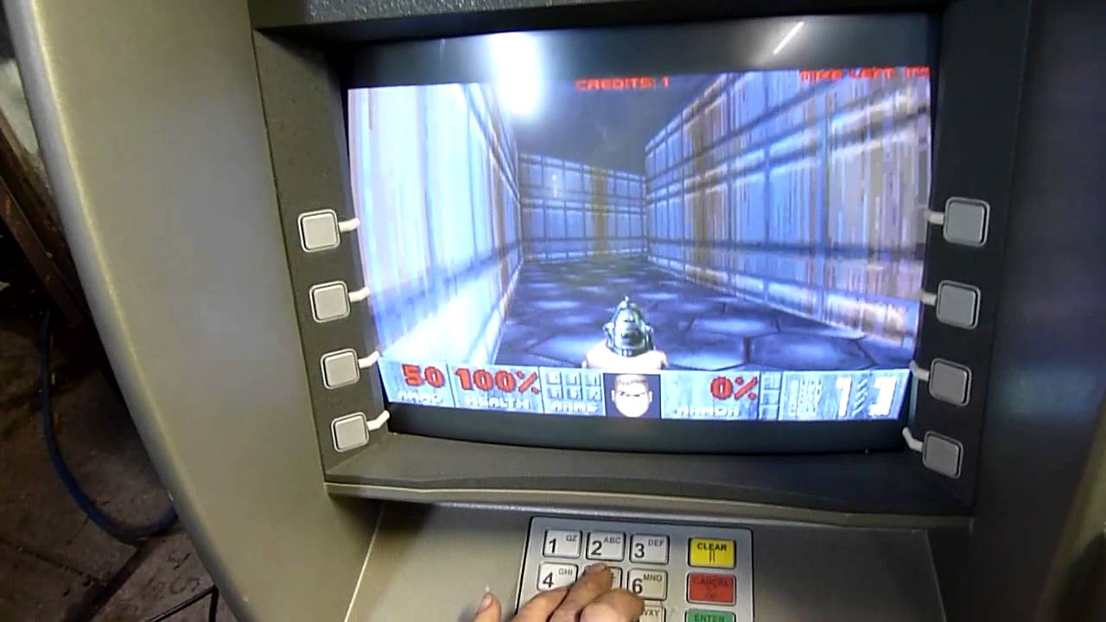
Free and Open Source: “It Runs Doom”
The DOOM source code has long been available to anyone since late 1997 and under an aggressively open license (GPL) since 1999.
Mirrored on GitHub: https://github.com/id-Software/DOOM/tree/master/linuxdoom-1.10
The modern port is GZDoom: https://zdoom.org/downloads
The availability has allowed it to be studied by academics such as myself.
And it has been ported to ATMs and such because why not. “It Runs Doom”
It lives forever, essentially, as is the power of the open-source community.
Doom running on a (decommissioned) bank ATM

Slide 8
The Design
A multi-dimensional illusion in a game about teleporter mishaps. Fun!

Slide 9
The game, at a high-level
A faux-3D textured environment.
Controlled movement only happens on X and Y axis (That is, no jumping.)
No slopes. All walls come to right angles with floors and ceilings.
Fixed angle of view. Cannot look up or down or tilt the “camera.”
However, you can ascend vertically via stairs or simple elevators.
Monsters populate each level and have minor intelligence to follow you by sight or sound and attack you or other monsters.
When monsters are struck by another’s projectile, they start attacking each other. Called “monster infighting”.
Items populate the level and are picked up by colliding with them.
These include common genre tropes: ammo, health, armor.

Slide 10
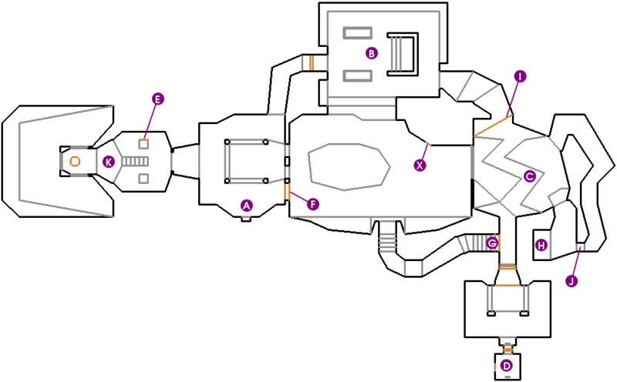
Faux-3D Simplicity
Level is 2D
Simplifies a lot of geometry math.
Goal: Get to exit.
First level of Doom (E1M1) via doomwiki.org

Slide 11
Layout and Conventions
This showcases some weird C styling generally for greater speed/portability.

Slide 12
Coding Style
UpperCase function names.
A_ prefix denotes subsystem or category.
A good strategy to mitigate C’s lack of classes or namespaces in large projects!
Allman/BSD style
Braces on their own line.
ANSI C (C89) dialect.
Variables declared at top.
Passes arguments by-ref
Avoids return values often.
Prefers pointers to structs.
//
// A_TroopAttack
//
void A_TroopAttack (mobj_t* actor)
{
int damage;
if (!actor->target)
return;
A_FaceTarget (actor);
if (P_CheckMeleeRange (actor))
{
S_StartSound (actor, sfx_claw);
damage = (P_Random()%8+1)*3;
P_DamageMobj (actor->target, actor, actor, damage);
return;
}
// launch a missile
P_SpawnMissile (actor, actor->target, MT_TROOPSHOT);
}

Slide 13
Header files and global variables…
doomdef.h
Separating C code into multiple files:
*.h files contain types/enums and function declarations.
*.c files will contain function implementations.
The extern says “Don’t create this. It exists somewhere else.”
It makes a global available to other C files. They just #include the header.
You declare it once (without extern) in the corresponding C file.
Therefore, each C file can share data.
// Game mode handling - identify IWAD version
// to handle IWAD dependend animations etc.
typedef enum
{
shareware, // DOOM 1 shareware, E1, M9
registered, // DOOM 1 registered, E3, M27
commercial, // DOOM 2 retail, E1 M34 retail,
// DOOM 1 retail, E4, M36
indetermined // Well, no IWAD found.
} GameMode_t;
doomstat.h
// ----------------------------------------------
// Game Mode - identify IWAD as shareware,
// retail etc.
extern GameMode_t gamemode; // Says there is a
// gamemode variable
// somewhere...
doomstat.c
GameMode_t gamemode; // The ACTUAL gamemode variable

Slide 14
Header files and global variables…
g_game.h
Separating C code into multiple files:
*.h files contain types/enums and function declarations.
*.c files will contain function implementations.
You can declare functions without implementations.
Typically for header files.
Implement them in their *.c file.
g_game.c in this case
Including this header file will allow use of this function.
//
// GAME
//
void G_DeathMatchSpawnPlayer (int playernum);
void G_InitNew (skill_t skill, int episode, int map);
// Can be called by the startup code or M_Responder,
// calls P_SetupLevel or W_EnterWorld.
void G_LoadGame (char* name);
void G_DoLoadGame (void);
// Called by M_Responder.
void G_SaveGame (int slot, char* description);
void G_ExitLevel (void);
void G_SecretExitLevel (void);
void G_WorldDone (void);

Slide 15
Header files and global variables…
g_game.c
Here we see the implementations of some of the functions.
Doom likes its private global data!
No file in the Doom source code defines secretexit as extern so only this file can use it!
Cultural artifacts become code.
Code reflects culture.
The secret levels in Doom are in the style of their earlier WWII-era game, Wolfenstein 3D.
They need to special case some code because German law does not allow Nazi imagery.
// wilkie's note: remember boolean isn't defined by C!
boolean secretexit;
// wilkie's note: gameaction_t defined elsewhere
gameaction_t gameaction;
void G_ExitLevel (void)
{
secretexit = false;
gameaction = ga_completed;
}
// Here's for the german edition.
void G_SecretExitLevel (void)
{
// IF NO WOLF3D LEVELS, NO SECRET EXIT!
if ( (gamemode == commercial)
&& (W_CheckNumForName("map31")<0))
secretexit = false;
else
secretexit = true;
gameaction = ga_completed;
}

Slide 16
Bugs happen to all of us…
d_main.c
if ( !access (plutoniawad, R_OK ) )
{
gamemode = commercial;
D_AddFile (plutoniawad);
return;
}
if ( !access (doom1wad,R_OK) )
{
gamemode = shareware;
D_AddFile (doom1wad);
return;
}
}
checks if file exists
(0 on success)
#include "doomdef.h"
#include "doomstat.h“
#include <unistd.h> // for 'access’
#include <stdlib.h> // for 'getenv'
#include <stdio.h> // for 'sprintf’
// Checks availability of IWAD files by name,
// to determine whether registered/commercial features
// should be executed (notably loading PWAD's).
void IdentifyVersion (void) {
char* doom1wad;
char* plutoniawad;
char* doomwaddir = getenv("DOOMWADDIR");
if (!doomwaddir)
doomwaddir = ".";
// Shareware.
doom1wad = malloc(strlen(doomwaddir)+1+9+1);
sprintf(doom1wad, "%s/doom1.wad", doomwaddir);
// Bug, dear Shawn.
// Insufficient malloc, caused spurious realloc errors.
plutoniawad = malloc(strlen(doomwaddir)+1+/*9*/12+1);
sprintf(plutoniawad, "%s/plutonia.wad", doomwaddir);
sets the gamemode global
sprintf is like printf,
but prints to a buffer.
Apparently, somebody corrected Shawn Green’s copy-and-paste of malloc.
It was not allocating enough space for the string copy!
Try not to copy and paste!!

Slide 17
The culture of bug hunting
A person that studies insects is called an entomologist.
However, the first documented case of a real-life insect causing an error in a computer was a moth. A story chronicled by Grace Hopper.
Somebody who studies moths/butterflies is called a lepidopterist.
(This will not be on the exam)
Ok… ok… the word bug in engineering is hundreds of years old.
We’re not sure where it actually comes from.
However, today, we call the modern bug hunter a “speedrunner.”
It’s a bit of an artform of its own these days.
The fear of moths is called Mottephobia.

Slide 18
Looking at things at another angle…
4shockblast, E1M1 UV/Pacifist, 0:08s - Record set in 2019 after 22 years unbroken
https://www.youtube.com/watch?v=1UkeFwJ-yHI
Consider:
In what weird way is the player moving?
Do you believe this to be intentional? Why might that be faster?

Slide 19
Speedrunning
Gotta go fast. Speedrunning is just a mistake made beautiful.

Slide 20
Going fast is not always “straight-forward”
If you notice from the video, the speedrunner is running at an angle.
This allows them to move at a higher speed.
To figure out why this works, we can consult the source code.
First, some information:
Doom lets you move forward and backward and turn left and right.
There is also the ability to use keys to strafe left and right instead.
Strafing moves you side by side (like a crabwalk)
Let’s see how Doom implements movement!

Slide 21
We’re drifting in two directions
p_user.c
First, it makes sure the player is on the ground.
If so, and you are pressing “forward” move the player forward!
If so, and you are pressing “strafe” (sidemove), move the player sideways!
Wait! What if both happen?
boolean onground;
//
// P_MovePlayer
//
void P_MovePlayer (player_t* player)
{
ticcmd_t* cmd;
cmd = &player->cmd;
player->mo->angle += (cmd->angleturn<<16);
// Do not let the player control movement
// if not onground.
onground = (player->mo->z <= player->mo->floorz);
if (cmd->forwardmove && onground)
P_Thrust (player, player->mo->angle, cmd->forwardmove*2048);
if (cmd->sidemove && onground)
P_Thrust (player, player->mo->angle-ANG90, cmd->sidemove*2048);
}
yes, double dereferences are a thing!
The 2048 is a scalar; to avoid floating point!

Slide 22
What’s the Hypotenuse
Holding both forward and strafe keys down moves the player.
These are both independent movement.
The cmd->forwardmove is, at most, 50
The cmd->sidemove is, at most, 40
(These are set in g_game.c)
Therefore, you are moving:
50 units forward
40 units sideways
Hence, we call this trick “strafe 40” or SR-40
For a total speed of:
64 units/second
64 units/s !!
50 units/s
40 units/s

Slide 23
Can we do better?
Doom lets you use a single key to strafe left and right.
It also lets you press a toggle to repurpose the left and right keys.
So, if you press this “strafe toggle” key, left and right no longer turn you.
They strafe you.
Let’s look at the Doom code for how this is implemented.

Slide 24
Let’s go even faster!
g_game.c
if (gamekeydown[key_up])
forward += forwardmove[speed];
if (gamekeydown[key_down])
forward -= forwardmove[speed];
if (gamekeydown[key_straferight])
side += sidemove[speed]; // This is 40
if (gamekeydown[key_strafeleft])
side -= sidemove[speed];
if (forward > MAXPLMOVE)
forward = MAXPLMOVE;
else if (forward < -MAXPLMOVE)
forward = -MAXPLMOVE;
if (side > MAXPLMOVE)
side = MAXPLMOVE; // What is this, at most?
else if (side < -MAXPLMOVE)
side = -MAXPLMOVE;
cmd->forwardmove += forward;
cmd->sidemove += side;
}
#define MAXPLMOVE 50
void G_BuildTiccmd (ticcmd_t* cmd) {
boolean strafe;
int speed;
int forward;
int side;
strafe = gamekeydown[key_strafe];
speed = gamekeydown[key_speed]; // The "run" button
forward = side = 0;
// let movement keys cancel each other out
if (strafe) {
if (gamekeydown[key_right]) {
side += sidemove[speed]; // This is 40
}
if (gamekeydown[key_left]) {
side -= sidemove[speed];
}
}
The normal strafe key.
Whether or not the “strafe toggle” is on
If so, “right” strafes right.
I removed the else which turned the player

Slide 25
What’s the Hypotenuse (revisited)
Forward and both types of strafe moves the player very quickly.
These are both independent movement.
The cmd->forwardmove is, at most, 50
The cmd->sidemove is now, mistakenly, 50
(These are set in g_game.c)
Therefore, you are moving:
50 units forward
50 units sideways
Hence, we call this trick “strafe 50” or SR-50
For a total speed of:
71 units/second
71 units/s !!!
50 units/s
50 units/s

Slide 26
Out-running Rockets: GOING FASTER STILL
The WALLRUN.LMP demo file from E2M8.
https://www.youtube.com/watch?v=xJ7PgOJKbEk

Slide 27
The “Wall Run”
The reason behind this behavior was unknown for quite some time.
However, the wall-run has to do with improper collision handling.
When you hit a wall, you slide along it.
There is some friction (you should SLOW down)
And some code to carry your momentum along the angle of the wall. (a vector projection)
However, for certain walls it speeds up.
Going exactly north along a wall.
Going exactly east along a wall.
Wall
Velocity
Intended Behavior

Slide 28
Let’s go even faster!
This function moves objects given their momentum.
do {
if (xmove > MAXMOVE/2 || ymove > MAXMOVE/2) {
ptryx = mo->x + xmove/2; // Move half-way
ptryy = mo->y + ymove/2;
xmove >>= 1; // Divides by two,
ymove >>= 1; // we move this much next time
}
else {
ptryx = mo->x + xmove; // Move the
ptryy = mo->y + ymove; // whole way.
xmove = ymove = 0; // We are done moving
}
if (!P_TryMove (mo, ptryx, ptryy)) {
// blocked move
if (mo->player) {
// try to slide along it
P_SlideMove (mo);
}
else
mo->momx = mo->momy = 0;
}
} while (xmove || ymove);
}
p_mobj.c
When moving quickly, it moves half-way twice.
#define MAXMOVE 30
void P_XYMovement (mobj_t* mo) {
fixed_t ptryx; // Position-try-x,
fixed_t ptryy; // "-try-y: The possible new position
fixed_t xmove; // Amount to move along x
fixed_t ymove; // Amount to move along y
if (mo->momx > MAXMOVE)
mo->momx = MAXMOVE;
else if (mo->momx < -MAXMOVE)
mo->momx = -MAXMOVE;
if (mo->momy > MAXMOVE)
mo->momy = MAXMOVE;
else if (mo->momy < -MAXMOVE)
mo->momy = -MAXMOVE;
xmove = mo->momx;
ymove = mo->momy;
However, the slide-along-walls function did not get the memo!

Slide 29
The “Wall Run” visualized
When going North or East, you’ve maximized your X or Y momentum respectively.
Going slightly north-east also works, but your momentum is, then, slightly split along X and Y.
This code looks at each momentum individually.
When the slide function is called twice with your original momentum… it causes… … well … dramatic results.
We call this an “Oops” in the trade.
Wall
Velocity
Unintended Behavior

Slide 30
Hmm, only North? Only East? Oh… Oops!
This function moves objects given their momentum.
do {
if (xmove > MAXMOVE/2 || ymove > MAXMOVE/2) {
ptryx = mo->x + xmove/2; // Move half-way
ptryy = mo->y + ymove/2;
xmove >>= 1; // Divides by two,
ymove >>= 1; // we move this much next time
}
else {
ptryx = mo->x + xmove; // Move the
ptryy = mo->y + ymove; // whole way.
xmove = ymove = 0; // We are done moving
}
if (!P_TryMove (mo, ptryx, ptryy)) {
// blocked move
if (mo->player) {
// try to slide along it
P_SlideMove (mo);
}
else
mo->momx = mo->momy = 0;
}
} while (xmove || ymove);
}
Momentum can be negative, yet…
p_mobj.c
#define MAXMOVE 30
void P_XYMovement (mobj_t* mo) {
fixed_t ptryx; // Position-try-x,
fixed_t ptryy; // "-try-y: The possible new position
fixed_t xmove; // Amount to move along x
fixed_t ymove; // Amount to move along y
if (mo->momx > MAXMOVE)
mo->momx = MAXMOVE;
else if (mo->momx < -MAXMOVE)
mo->momx = -MAXMOVE;
if (mo->momy > MAXMOVE)
mo->momy = MAXMOVE;
else if (mo->momy < -MAXMOVE)
mo->momy = -MAXMOVE;
xmove = mo->momx;
ymove = mo->momy;
How many times does this get called when momentum is VERY positive? And, VERY negative?
CS/COE 0449 – Spring 2019/2020

Slide 31
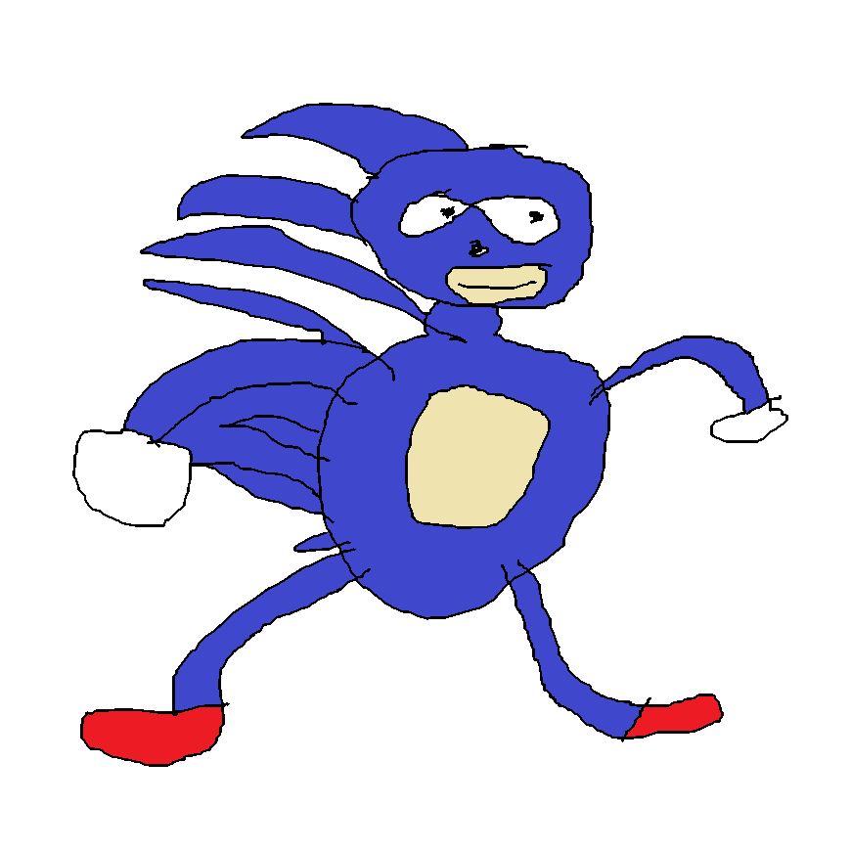
The “Wall Run” visualized
The closer you are to the wall and the smaller your angle…
The more like Sonic the Hedgehog you become.
Wall
Wall
Velocity
Velocity
Here I am at the end…
Ruining my slides…
I can’t believe this is 10 years old.
VERY Unintended Behavior

Slide 32
Closing Remarks
“I have not failed. I've just found 10,000 ways that won't work.”
— An elephant murderer talking about other people’s work

Slide 33
Consider
With your knowledge of C, you unlock a lot of potential.
You can figure out quite a few interesting things.
The “face” depicting the character will change based on the action.
However, this face only appeared in very odd circumstances.
Can you spot the bug? (Hint: you can both gain and lose health simultaneously.)
st_stuff.c
if (plyr->damagecount) { // ST_MUCHPAIN is 20
if (plyr->health - st_oldhealth > ST_MUCHPAIN) {
// Selects the VERY HURT character portrait:
st_faceindex = 3;
}
}
That face is kinda scary, so it’s probably for the best.

Slide 34
Are we DOOMed to fail?
In the end, I want to pass off some key knowledge nuggets:
Perfect code is an illusion used to sell textbooks.
We have gained more from these mistakes than if they weren’t there: art, culture, and enjoyment.
The speedrunning community finds art in our mistakes.
Fixing them does not improve the art, just hints at our vanity.
The art culture around failure is not about judgement, but exploration.
Do not come out of this course thinking perfection is the goal.
Mistakes in C can be costly for kernels, etc… sure.
However, in your day-to-day life, know that often these small mistakes are certainly common at all levels of skill. They can be fixed. They can be fun.
So, have fun writing and reading code!

