Slide 1

Investigating
8
CS/COE 0449
Introduction to
Systems Software
the Code
wilkie
(with content borrowed from Vinicius Petrucci
and Jarrett Billingsley)
Spring 2019/2020

Slide 2
Going with the Flow
Tracing the footsteps

Slide 3
Bringing back our alphabet soup: The C ABI
The C Application Binary Interface (ABI) are assembly conventions
  Like MIPS, certain registers are typically used for returns values, args, etc
  It is not defined by the language, but rather the OS.
    Windows and Linux (UNIX/System V) have a different C ABI ☹
In our x86-64 Linux C ABI, registers are used to pass arguments:
  %rdi, %rsi, %rdx, %rcx, %r8, %r9 (First, second, etc) (Like MIPS a0 – a3)
  Remaining arguments go on the stack.
  Callee must preserve %rbp, %rbx, %r12, %r13, %r14, %r15 (Like MIPS s0 – s7)
  Return value: %rax (overflows into %rdx for 128-bits) (MIPS v0 – v1)
  Lots of other small things not worth going over.
For reference: https://github.com/hjl-tools/x86-psABI/wiki/x86-64-psABI-1.0.pdf

Slide 4
Function, function… what’s your… function
The activation frame contains temporary data needed by the function.
  %rax is the return value
  %rsp is the current stack address
  %rbp is the address of this frame
%rsp
Return Address
? garbage ?
What goes here?
? garbage ?
C
x86-64 (gas / AT&T syntax, objdump -d)
int main(void) {
int x = 5;
int y = -2;
if (x < 0) {
x = -x;
}
if (x < y) {
x = y;
}
return 0;
}
0000000000001119 <main>:
1119: 55 push %rbp
111a: 48 89 e5 mov %rsp,%rbp
111d: c7 45 f8 05 00 00 00 movl $0x5,-0x8(%rbp)
1124: c7 45 fc fe ff ff ff movl $0xfffffffe,-0x4(%rbp)
112b: 83 7d f8 00 cmpl $0x0,-0x8(%rbp)
112f: 79 03 jns 1134 <main+0x1b>
1131: f7 5d f8 negl -0x8(%rbp)
1134: 8b 45 f8 mov -0x8(%rbp),%eax
1137: 3b 45 fc cmp -0x4(%rbp),%eax
113a: 7d 06 jge 1142 <main+0x29>
113c: 8b 45 fc mov -0x4(%rbp),%eax
113f: 89 45 f8 mov %eax,-0x8(%rbp)
1142: b8 00 00 00 00 mov $0x0,%eax
1147: 5d pop %rbp
1148: c3 retq

Slide 5
Oh, that’s your function
First: it fills the activation frame
with initial variable values.
  It may not allocate them in
  any strict order. Here, it
  allocates x first and further away.
(start/end) %rsp
Return Address
(After push) %rsp/%rbp
Old %rbp
y: %rbp – 0x4
0xfffffffe
x: %rbp – 0x8
0x00000005
x86-64 (gas / AT&T syntax, objdump -d)
0000000000001119 <main>:
1119: 55 push %rbp
111a: 48 89 e5 mov %rsp,%rbp
111d: c7 45 f8 05 00 00 00 movl $0x5,-0x8(%rbp)
1124: c7 45 fc fe ff ff ff movl $0xfffffffe,-0x4(%rbp)
112b: 83 7d f8 00 cmpl $0x0,-0x8(%rbp)
112f: 79 03 jns 1134 <main+0x1b>
1131: f7 5d f8 negl -0x8(%rbp)
1134: 8b 45 f8 mov -0x8(%rbp),%eax
1137: 3b 45 fc cmp -0x4(%rbp),%eax
113a: 7d 06 jge 1142 <main+0x29>
113c: 8b 45 fc mov -0x4(%rbp),%eax
113f: 89 45 f8 mov %eax,-0x8(%rbp)
1142: b8 00 00 00 00 mov $0x0,%eax
1147: 5d pop %rbp
1148: c3 retq
Preserves %rbp (caller activation frame)
Allocates “x” on stack (-8 from top)
Allocates “y” on stack (-4 from top)
(it does not have to be in order)
Resets caller activation frame
Returns (return value is in %rax)

Slide 6
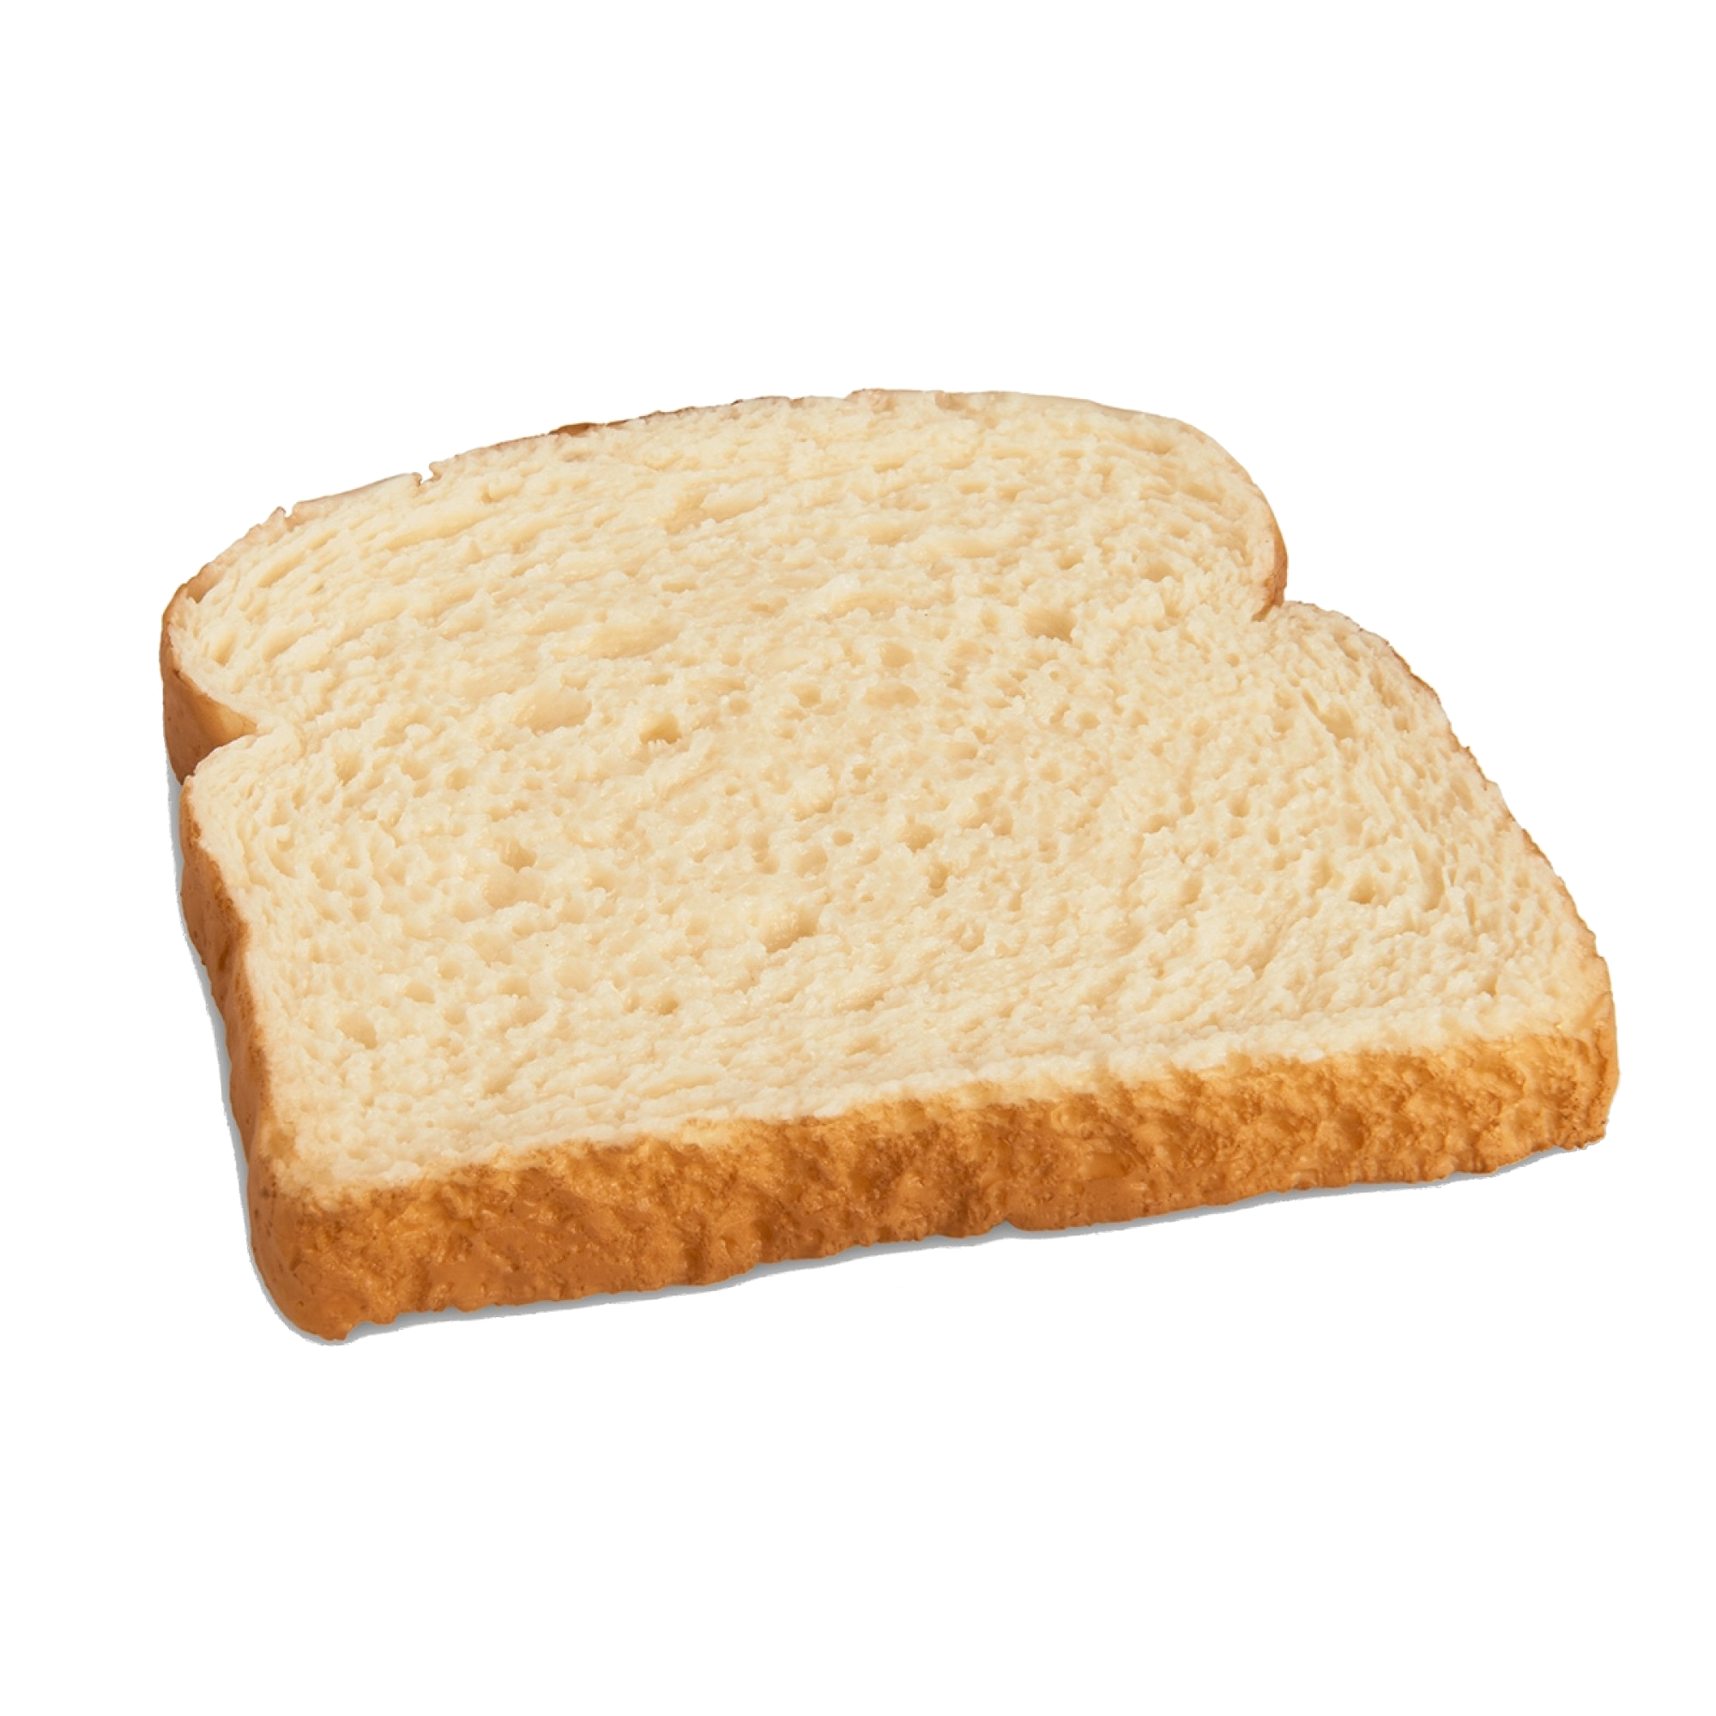
These are actual sandwiches (no hot dogs or w/e)
0000000000001119 <main>:
1119: 55 push %rbp
111a: 48 89 e5 mov %rsp,%rbp
111d: c7 45 f8 05 00 00 00 movl $0x5,-0x8(%rbp)
1124: c7 45 fc fe ff ff ff movl $0xfffffffe,-0x4(%rbp)
112b: 83 7d f8 00 cmpl $0x0,-0x8(%rbp)
112f: 79 03 jns 1134 <main+0x1b>
1131: f7 5d f8 negl -0x8(%rbp)
1134: 8b 45 f8 mov -0x8(%rbp),%eax
1137: 3b 45 fc cmp -0x4(%rbp),%eax
113a: 7d 06 jge 1142 <main+0x29>
113c: 8b 45 fc mov -0x4(%rbp),%eax
113f: 89 45 f8 mov %eax,-0x8(%rbp)
1142: b8 00 00 00 00 mov $0x0,%eax
1147: 5d pop %rbp
1148: c3 retq
When identifying functions, you are looking for that
tell-tale sandwich pattern.
A push is a good sign of the beginning of a function
And the pop will happen before the ret at the end.
Everything between is the sweet, sweet jam that makes it unique.

Slide 7

Who controls the cmp controls the flow
Control flow is a cmp or test followed by j*
  cmp will set FLAGS based on the difference (subtraction) between values
  test will set FLAGS based on bitwise AND of both values (faster, but less useful)
j* group set %rip (program counter) to an address based on FLAGS
  Often it is much more useful to just interpret the jmp ( jge is >= )
C
x86-64 (gas / AT&T syntax, objdump -d)
if (x < 0) {
x = -x;
}
if (x < y) {
x = y;
}
jmp
jge, jns,
jne, jle, jno
etc
cmpl $0x0,-0x8(%rbp)
jns 1134 <main+0x1b>
negl -0x8(%rbp)
mov -0x8(%rbp),%eax
cmp -0x4(%rbp),%eax
jge 1142 <main+0x29>
mov -0x4(%rbp),%eax
mov %eax,-0x8(%rbp)
test,
cmp

Slide 8

Who controls the cmp controls the flow
FLAGS has bits that are set based on the ALU (CPU math logic) result
  SF – most significant bit of result
  OF – set if overflow occurred
Each jump looks at different FLAGS patterns. (Look ‘em up!)
  jns – Jumps when SF = 0
  ZF – set if result is zero
  CF – set if last bit operation has carry
  jge – set if SF = OF or ZF = 1
C
x86-64 (gas / AT&T syntax, objdump -d)
if (x < 0) {
x = -x;
}
if (x < y) {
x = y;
}
cmpl $0x0,-0x8(%rbp)
jns 1134 <main+0x1b>
negl -0x8(%rbp)
mov -0x8(%rbp),%eax
cmp -0x4(%rbp),%eax
jge 1142 <main+0x29>
mov -0x4(%rbp),%eax
mov %eax,-0x8(%rbp)
Perform x - 0 (does nothing!)
Jump if the result (that is, x)
does not have a set sign bit.
(x is positive in that case)
Works because of 2’s
complement math.
(thus, instead of its strict definition,
better to think about it abstractly)
Perform x - y
Jump if the result is 0 or
if result is negative after overflow
or positive and didn’t overflow.
(x is >= y in these cases)

Slide 9
cmp, simplifying… the confusion
Just remember that the order of operands is not the… best order…
  It’s kinda swapped around in the AT&T syntax we have been looking at:
if (x < 0) {
}
if (x < y) {
}
if (x >= y) {
}
if (x == y) {
}
cmpl 0, x
jns <address>
cmpl y, x
jge <address>
cmpl y, x
jl <address>
cmpl y, x
jne <address>
Jump if x > 0
Jump if x >= y
We negate the
condition
Jump if x < y
Because we are
deciding when to
skip the code!
Jump if x != y

Slide 10
test… adding some new confusion
test is somewhat stranger… and requires some more thought.
  performs an AND of the arguments and sets flags on result
Thankfully, generally only commonly used in a couple of cases.
  Generally to test a value against “true” or “false”.
  Recall that jne and je will look at the zero flag ( FLAGS[ZF] )
  Keep in mind that jumps are built around cmp (which performs: x - x)…
if (!x) {
}
if (x) {
}
test x, x
jne <address>
test x, x
je <address>
We negate the
condition
Jump if x != 0
(ZF = 0?)
Jump if x == 0
(ZF = 1?)

Slide 11
Patterns
Control flow is a cmp / test before a j*
%rsp/%rbp
Old %rbp
C
int main(void) {
int x = 5;
int y = -2;
if (x < 0) {
x = -x;
}
if (x < y) {
x = y;
}
return 0;
}
y: %rbp – 0x4
0xfffffffe
x: %rbp – 0x8
0x00000005
x86-64 (gas / AT&T syntax, objdump -d)
0000000000001119 <main>:
1119: 55 push %rbp
111a: 48 89 e5 mov %rsp,%rbp
111d: c7 45 f8 05 00 00 00 movl $0x5,-0x8(%rbp)
1124: c7 45 fc fe ff ff ff movl $0xfffffffe,-0x4(%rbp)
112b: 83 7d f8 00 cmpl $0x0,-0x8(%rbp)
112f: 79 03 jns 1134 <main+0x1b>
1131: f7 5d f8 negl -0x8(%rbp)
1134: 8b 45 f8 mov -0x8(%rbp),%eax
1137: 3b 45 fc cmp -0x4(%rbp),%eax
113a: 7d 06 jge 1142 <main+0x29>
113c: 8b 45 fc mov -0x4(%rbp),%eax
113f: 89 45 f8 mov %eax,-0x8(%rbp)
1142: b8 00 00 00 00 mov $0x0,%eax
1147: 5d pop %rbp
1148: c3 retq

Slide 12
Altogether now… Working backward
0000000000001119 <main>:
1119: push %rbp // Preserve caller’s %rbp on stack
111a: mov %rsp,%rbp // Set %rbp to %rsp
111d: movl $0x5,-0x8(%rbp) // Store x on stack with value of 5
1124: movl $0xfffffffe,-0x4(%rbp) // Store y on stack with value of -2
112b: cmpl $0x0,-0x8(%rbp)
112f: jns 1134 <main+0x1b> // if (x < 0) {
1131: negl -0x8(%rbp) // x = -x
// }
1134: mov -0x8(%rbp),%eax
1137: cmp -0x4(%rbp),%eax
113a: jge 1142 <main+0x29> // if (x < y) {
113c: mov -0x4(%rbp),%eax
113f: mov %eax,-0x8(%rbp) // x = y
// }
1142: mov $0x0,%eax
1147: pop %rbp // Recall caller’s %rbp from stack
1148: retq // return 0
Negate logic to form “if” logic
Negate logic to form “if” logic

Slide 13
Deduction, dear watson
0000000000001119 <main>:
1119: push %rbp
111a: mov %rsp,%rbp
111d: movl $0x5,-0x8(%rbp)
1124: movl $0xfffffffe,-0x4(%rbp)
112b: cmpl $0x0,-0x8(%rbp)
112f: jns 1134 <main+0x1b>
1131: negl -0x8(%rbp)
1134: mov -0x8(%rbp),%eax
1137: cmp -0x4(%rbp),%eax
113a: jge 1142 <main+0x29>
113c: mov -0x4(%rbp),%eax
113f: mov %eax,-0x8(%rbp)
1142: mov $0x0,%eax
1147: pop %rbp
1148: retq
No use of %rdi … likely no arguments
Two stack allocations … Two local variables.
(initialized to 5 and, likely, -2)
Looking at %rax … This simply returns zero.

Slide 14
Conventional wisdom: counting arguments
000000000000112d <main>:
112d: 55 push %rbp
112e: 48 89 e5 mov %rsp,%rbp
1131: be 03 00 00 00 mov $0x3,%esi
1136: bf 05 00 00 00 mov $0x5,%edi
113b: e8 d9 ff ff ff callq 1119 <whoknows>
1140: b8 00 00 00 00 mov $0x0,%eax
1145: 5d pop %rbp
1146: c3 retq
Readies %rsi … second argument!
Readies %rdi … first argument!
Since they are %e* … yep! Both 32-bit!
Like a jal in MIPS. A function call.
???
whoknows (
int
a,
int
b
) {
// Let’s assume int is 32 bits
???
Still have to follow the call to the assembly of the function.
}

Slide 15
Conventional wisdom: counting arguments
0000000000001119 <whoknows>:
1119: 55 push %rbp
111a: 48 89 e5 mov %rsp,%rbp
111d: 89 7d fc mov %edi,-0x4(%rbp)
1120: 89 75 f8 mov %esi,-0x8(%rbp)
1123: 8b 55 fc mov -0x4(%rbp),%edx
1126: 8b 45 f8 mov -0x8(%rbp),%eax
1129: 01 d0 add %edx,%eax
112b: 5d pop %rbp
112c: c3 retq
Copies %rdi … function argument!
Copies %rsi … second argument!
Since they are %e* … They are both 32-bit!
%rax is the return address…
%eax means it is a 32-bit return
%eax = %eax + %edx
= a + b
int
whoknows (
int
a,
int
b
) {
// Let’s assume int is 32 bits
return
a + b
;
}

